Slide 1
Assignment 4 – Support Vector Machine & Naive bayes Introduction to Data Analysis (DATA 1200) Prof. Ritwick Dutta
Dheer Parikh
100919437

Slide 2
Introduction
In this assignment we have to predict the type of rice i.e. `Kesimen` or `Besni` by leveraging the dataset ‘raisin_dataset.csv’ by applying two algorithms namely Support Vector Machine & Naïve Bayes, and compare the difference of their outcomes.

Slide 3
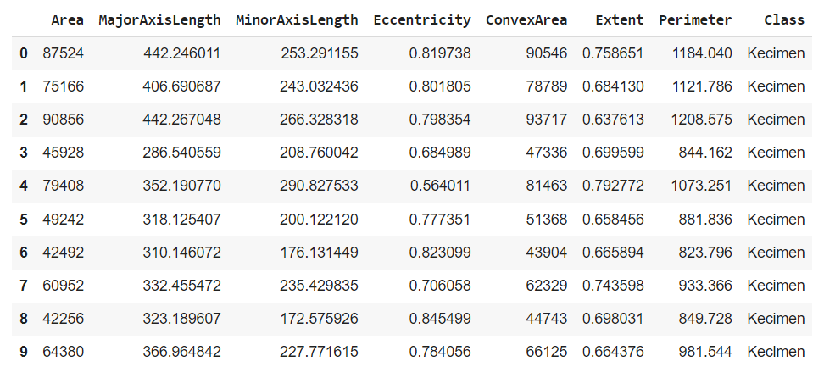
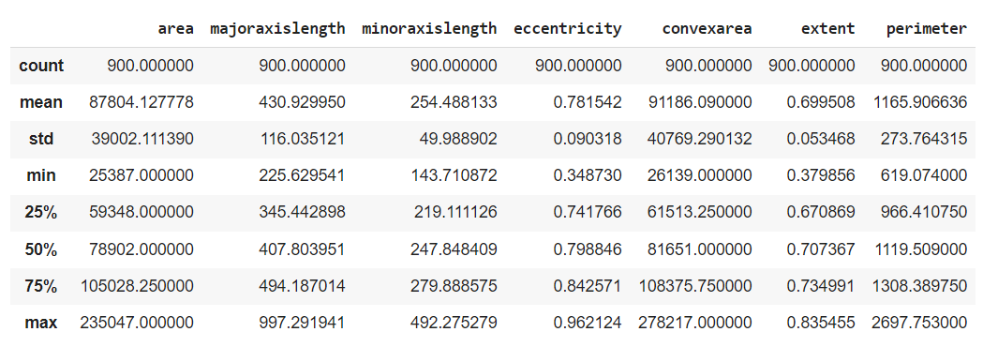
Understanding dataset:
Fig. 1 – first 10 rows of dataset
Fig. 2 – statistical description of dataset
From the given dataset it can be seen that the information is in pixel it means that this resembles to pictures which were converted to pixel form. The primary focus of this project is to identify the Class of rice on the bases of Area: No. of pixels within the boundary of Raisin , Major Axis Length: Longest line that can be drawn on raisin, Minor Axis Length: shortest line that can be drawn on raisin, Convex Area:, Extent: Ratio of raisin covered under pixels by total pixels, Perimeter: Distance between boundaries and pixel around raisin, eccentricity: eccentricity of eclipse which has same moment as raisin along with our target variable which is Class, which contains two values namely Kecimen and Besni.
From the descriptive stats, there are 900 observation with no null values in it. As it seems that this are the data in picture format which are converted to pixel format, the maximum area covered by any raisin is 235047 pixels, major axis length is 997.29, minor axis length is 492.27. Notable thing from the dataset is the standard deviation is comparatively high for most of the variable expect eccentricity, which suggests that there might be some outliers and dataset might not follow normal distribution curve.

Slide 4
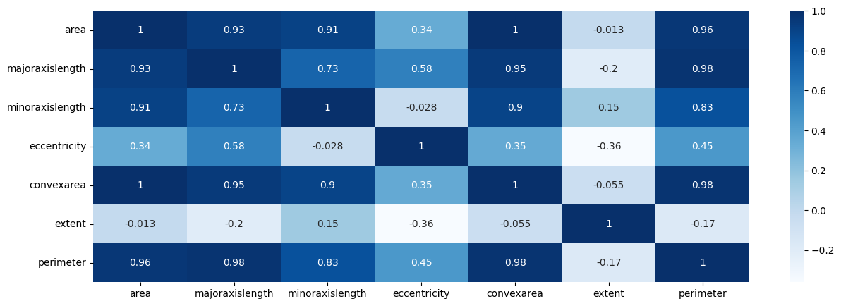
Understanding Correlations:
Fig. 6 – Correlation plot
The Co-relation of Area is greater than 0.90 with every other variable other than Eccentricity, whereas it has negative relationship tending towards 0 with extent.
Extent doesn’t have good co-relation with most of the variables, it only exhibits significant negative correlation of -0.36 with Eccentricity.
Eccentricity have comparatively low co-relation with variables, it has co-relation of 0.58 with major axis length followed by perimeter which is 0.45.

Slide 5
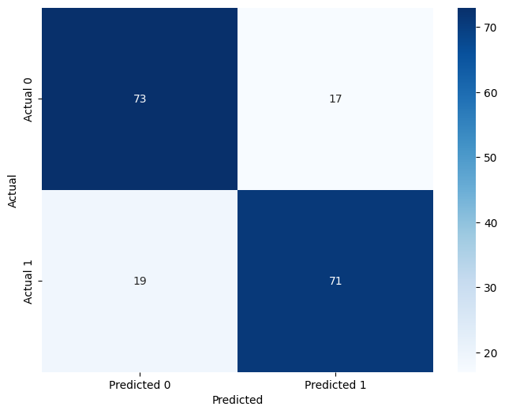
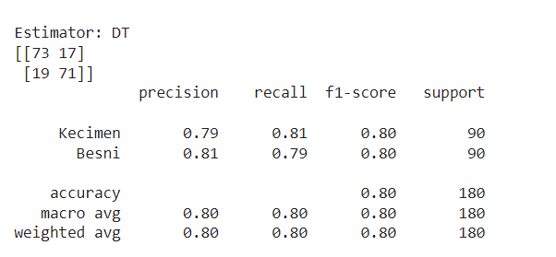
Interpretation of Decision Tree Classification:
Fig. 8 – Performance Matrices
Fig. 9 – Confusion Matrices
From the performance it can be seen that the model deployed is little bit more precise towards predicting Raisin of class Besni and is 80% accurate to predict the true results.
From the confusion matrix it can be seen that model has predicted nearly equal False positive & True Negative. It can be also seen that both the class predicted has equal number.
The F-1 Score and Support for both class is same, whereas recall for Kecimen is slightly higher than Besni.

Slide 6
Ways to improve model:
Data cleaning must be done. From the descriptive statistics it is clear that there can be many outliers and decision tree models are prone to outliers. Hyperparameters must be tuned properly.
For such tasks, tree based classification such as Random Forest Classification, Gradient Boosting Classification can be leveraged as these takes in account of many such decision tree and by voting method they do classification.
As the dataset seems to be originally in picture format converted to pixel format, deep learning techniques might be an option to be consider.

